Slide 1
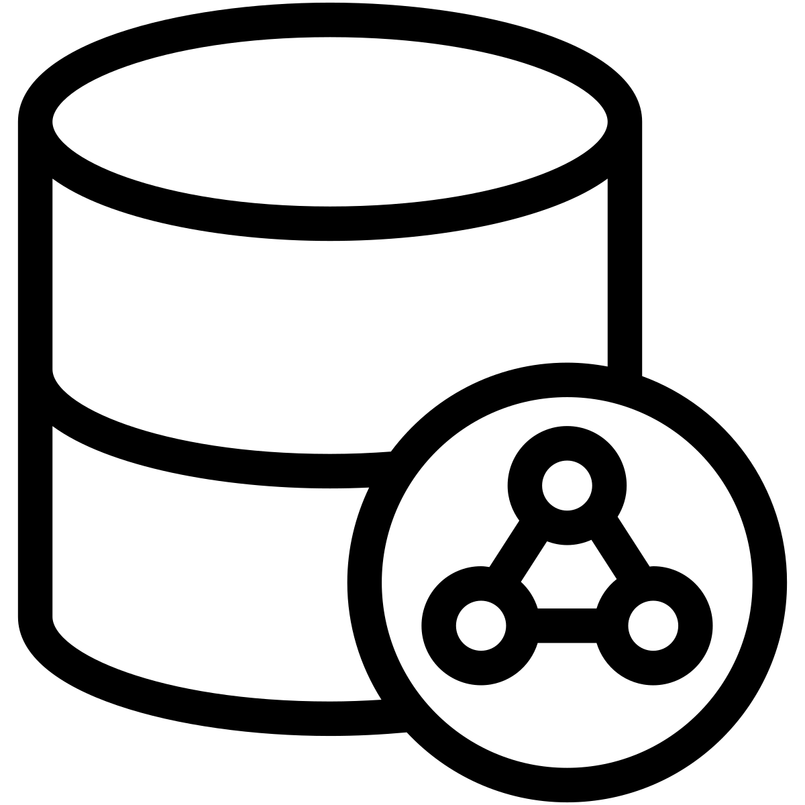
The data layer
2023-24

Slide 2
Models
The model abstraction is responsible for implementing the application logic and persisting the application state
It is further divided into several sub-components
The Business Logic (a.k.a. Domain Model) implements the application business logic and relies on local and/or remote data sources to maintain the application state
The Remote Data Source contains the code necessary to access a remote server, that usually represents the primary information source
The Local Data Source contains the code necessary to persist and retrieve the application state from the local storage (often a DBMS), which can either be the only source of information (for stand-alone apps) or be a cache of the remote server, used when the app is disconnected from the network

Slide 3
Models
Models are independent from Views and any other Android component
They are isolated from the complex components lifecycle
Managing separately the UI code from the application logic makes it easier to maintain the app and enables testing
Data managed from the model should have a neutral representation, driven only by the domain requirements
Although the information contained inside mimics the one stored in the database or in the remote server, it should not reflect the details imposed by such technologies
Data coming from the remote server is usually denoted as DTOs - Data Transfer Objects
Data coming from the local database is denoted as Entities

Slide 4
Asynchronous updates
Model state may evolve as a consequence of different reasons
Some may be local to the app, some are remote
In most cases, these updates are asynchronous
They may happen at any time, possibly conflicting with the evolution of the components' lifecycle
In order to react to state changes, models can provide their contents as LiveData<T> objects
Alternatively, they must propagate data updates via call-backs to the ViewModel (taking care not to store permanent
Kotlin Flow<T> abstractions or RxJava observables may also be used to this purpose (more on these in a later lecture)

Slide 5
Long running operations
Whether the data layer is implemented locally or remotely, operating on it may require a noticeable amount of time
Some of the operations may even block the invoker thread
Android forbids long running operations from being executed on the main thread
If this is happening, the application may be killed by the OS reporting an Application Not Responding (ANR) error
This means that the model should be invoked on a different thread
Usually the ViewModel must take care of this
This can be significantly simplified by using the Kotlin coroutine libraries

Slide 6
Model architecture
ViewModel
Model
Business Logic
Observable
Local Data Source
Remote Data Source
Room
Retrofit
references
SQLite
Network
notifies

Slide 7
Implementing the model
The business logic class exposes a set of methods that corresponds to the actions the user can perform in the various application use cases
Depending on how the data layer is implemented (only locally, only remotely, both locally and remotely), these actions may contain more or less logic
Model also encompasses tasks such as data conversion, filtering, merging, and sorting
It transforms the raw data received from the data layer into a processed format that is convenient and manageable for the presentation layer to handle

Slide 8
Implementing the local data layer
If an application has to operate offline, it must be in charge of guaranteeing data persistence
This can be achieved by saving information in raw files
Or leveraging on a DBMS, if there is a larger amounts of data or they need to be stored in a more structured manner
Android natively support the SQLite DBMS
It uses a single file in the local application filesystem to store all the tables
However, directly accessing its APIs may be inconvenient
Since they provide no compile-time verification of raw SQL queries
And also because of the amount of boilerplate code that must be provided

Slide 9
The Room Persistence Library
The Room library provides an abstraction layer over SQLite
It is an ORM (Object-to-Relational Mapping) library provided by Google
Required Gradle dependencies
dependencies {
val room_version = "2.6.1"
implementation("androidx.room:room-runtime:$room_version")
annotationProcessor("androidx.room:room-compiler:$room_version")
kapt("androidx.room:room-compiler:$room_version")
// optional - Kotlin Extensions and Coroutines support for Room
implementation("androidx.room:room-ktx:$room_version")
}

Slide 10
Room-compiler
Annotation processor that operates in the Gradle build pipeline and generates Java code starting from your annotated classes
Useful when dealing with domain specific languages, DSL’s
Butterknife
Dagger
http://hannesdorfmann.com/annotation-processing/annotationprocessing101

Slide 11
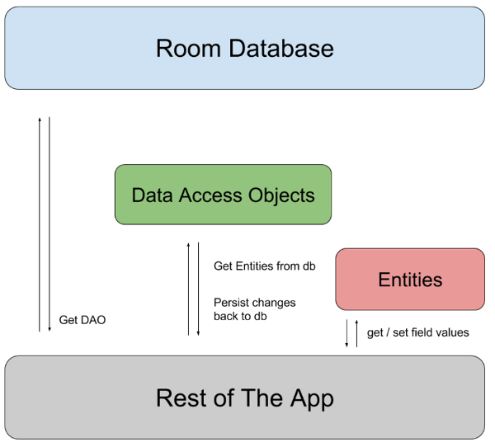
Room – overview

Slide 12
Components of Room
Database
Contains the database holder and represents the main entry point to access the persisted relational data
Entity classes
Each of them represents a single table within the database
Their instances represent single rows in a table
DAOs – Data Access Objects
Helper interface that declares the methods that will be used to access a table in the DB (it will be implemented by the Room Annotation Processor)

Slide 13
Components - Database
Abstract class that extends class RoomDatabase
Annotated with @Database
The annotation should list all the entities referred to by the DAO objects
It must contain abstract methods with no arguments that returns the DAO instances
It may also contain a static method for DB creation
Database instances must be singletons

Slide 14
Sample Entity class
@Entity(tableName = "users") data class User ( @PrimaryKey(autoGenerate = true) val id: Int = 0, @ColumnInfo(name = "first_name") val firstName: String, @ColumnInfo(name = "last_name") val lastName: String )

Slide 15
Sample DAO interface
@Dao interface UserDao { @Query("SELECT * FROM users") fun getAll() : LiveData<List<User>>
@Query("SELECT * FROM user WHERE uid IN (:userIds)") fun loadAllByIds(userIds: List<Int>): LiveData<List<User>>
@Query("SELECT * FROM user WHERE first_name LIKE :first AND " + "last_name LIKE :last LIMIT 1") fun findByName(first: User, last: String): User
@Insert(onConflict = REPLACE) fun save(user: User)
//@Update //NOT NEEDED because of the REPLACE on the above method //fun update(user: User)
@Delete fun delete(user: User) }

Slide 16
The Database class
@Database(entities = [User::class], version = 1) abstract class UserDatabase: RoomDatabase() { abstract fun userDao(): UserDao
companion object {
@Volatile
private var INSTANCE: UserDatabase? = null
fun getDatabase(context: Context): UserDatabase =
(INSTANCE ?: synchronized(this) {
val i = INSTANCE ?: Room.databaseBuilder(context.applicationContext, UserDatabase::class.java, "user_database").build()
INSTANCE = i
INSTANCE
})!!
}
} }
val db = UserDatabase.getDatabase(application)
Db access must be performed in a secondary thread otherwise Android will stop your application

Slide 17
Defining data using Entities
Database schema is driven by the class structure: by default Room creates a column for each field
With @Ignore you can flag data that must not be persisted
You can change the column name via the annotation @ColumnInfo(name = "first_name")
Each entity must define at least one primary key with the @PrimaryKey annotation
To add indices to an entity, include the indices within the @Entity annotation
@Entity(indices = {@Index("name"), @Index(value = {"last_name", "address"})})

Slide 18
Defining data using Entities
Uniqueness can be specified with the property unique of a @Index annotation set to true
Relationships are expressed through the @ForeignKey annotation passed as a property to the @Entity one
SQLite handles @Insert(onConflict = REPLACE) as a set of REMOVE and REPLACE operations instead of single update one. This method could affect the foreign keys constraints
By setting onDelete = CASCADE in the @ForeignKey annotation you can tell SQLite to delete all related items, if the source record is removed
@Entity(foreignKeys = @ForeignKey(entity = User.class, parentColumns = "id", childColumns = "user_id"))

Slide 19
Accessing data
Data can be retrieved either as instances of the entities classes or it can be wrapped by LiveData<T> or Flow<T>
@Dao interface MyDao { @Query("SELECT first_name, last_name FROM user WHERE region IN (:regions)") fun loadUsersFromRegionsSync(List<String> regions): LiveData<List <User>> }
@Dao public interface MyDao { @Query("SELECT * from user where id = :id LIMIT 1") fun loadUserById(int id): Flow<User> }

Slide 20
Accessing data
If necessary, data can also be accessed via Cursor objects
@Dao interface MyDao { @Query("SELECT * FROM user WHERE age > :minAge LIMIT 5") fun loadRawUsersOlderThan(minAge: Int): Cursor }
// a further example that looks up multiple tables
@Dao interface MyDao { @Query("SELECT * FROM book " + "INNER JOIN loan ON loan.book_id = book.id " + "INNER JOIN user ON user.id = loan.user_id " + "WHERE user.name LIKE :userName") fun findBooksBorrowedByNameSync(userName: String): List<Book> }

Slide 21
Maintaining the DB
As you add and change features in your app, your DB evolves and your entity classes may change
Room provides the migrations mechanism for this particular need
Room.databaseBuilder(applicationContext, MyDb::class.java, "database-name") .addMigrations(MIGRATION_1_2, MIGRATION_2_3).build() val MIGRATION_1_2 = object : Migration(1, 2) { override fun migrate( database : SupportSQLiteDatabase) { database.execSQL("CREATE TABLE `Fruit` (`id` INTEGER, `name` TEXT, PRIMARY KEY(`id`))") } }; val MIGRATION_2_3 = Migration(2, 3) { override fun migrate(database : SupportSQLiteDatabase) { database.execSQL("ALTER TABLE Book ADD COLUMN pub_year INTEGER") } };

Slide 22
Accessing the network
If the application logic is based on the services provided by a remote server, it is necessary to implement a suitable client interface
Most servers expose REST APIs based on an HTTP(S) endpoint, transferring JSON-encoded data
Android offers the java.net.HttpURLConnection class, which supports both HTTP and HTTPS protocols
However, such a class provides a very low level implementation, requiring a lot of boilerplate code and gives no support for encoding/decoding the payload
So, often, a suitable library is used
Application must request internet permission in the manifest file
<uses-permission android:name="android.permission.INTERNET" />

Slide 23
The Retrofit library
Retrofit is a type safe HTTP client for Android and Java
Analogously to Room, it uses annotations to describe the HTTP requests
It has a modular architecture and allows different converter to be used for JSON mapping
Requested dependencies
dependencies {
implementation 'com.google.code.gson:gson:2.10'
implementation 'com.squareup.retrofit2:retrofit:2.9.0'
implementation 'com.squareup.retrofit2:converter-gson:2.9.0'
}

Slide 24
Modelling API data
Any data to be exchanged via the API will be mapped to a corresponding data class
If the property names cannot match the name of the serialized attributes, the @SerializedName(...) annotation will be used, to support proper conversions
data class ToDo (
val id: Int,
@SerializedName("task-description")
val taskDescription: String,
val before: LocalDate
)

Slide 25
Describing the service
The set of API to be contacted will be defined as methods of an interface
Each method is to annotated with the corresponding HTTP method and the relative URL
Method parameters will be annotated to convey the intended semantics
@Body - Sends Java objects as request body
@Url(…) - use dynamic URLs
@Query(…) - Sends the value in the query string, with the corresponding name
@Field(…) - send data as form-urlencoded
This requires a @FormUrlEncoded annotation attached with the method
The @Field parameter works only with a POST request

Slide 26
Describing the service
Retrofit is quite flexible in the definition of the returned values
By default, it supports methods returning instances of the retrofit2.Call<T> objects, where T is response body type
When using it, it is responsibility of the caller to execute the request, either synchronously, via the execute() method, or asynchronously, with equeue(Callback<T>)
However, the library supports CallAdapters that can generate implementations for different kinds of invocation and return values
Methods can be defined as suspend fun and directly return the response body type
Or can be normal fun, but having a LiveData<T> as a return value
In both cases, the request will be executed automatically, just calling the method

Slide 27
Describing the service
interface APIInterface {
@POST("/api/users")
suspend fun createUser(@Body user: User): User
@GET
suspend fun getUsers(@Url url: String): List<User>
@GET("/api/users?")
suspend fun doGetUserList(@Query("page") page: String): List<User>
@FormUrlEncoded
@POST("/api/users?")
suspend fun doCreateUserWithField( @Field("name")name:String,
@Field("job") job: String
): User
}

Slide 28
Creating the service
The service implementation will be automatically generated by creating a custom instance of the Retrofit object
This will be configured with the base URL of the server endpoint
As well as with a reference to the actual converter to use for encoding/decoding JSON data
A singleton object exposing a method for creating the service will typically be created
This will expose a single generic method responsible of instantiating the actual service interface

Slide 29
Creating the service
object ApiInstance {
private val gson = GsonBuilder().create()
private val retrofitBuilder: Retrofit.Builder =
Retrofit.Builder()
.baseUrl("http://10.0.2.2:8080/")
.addConverterFactory(GsonConverterFactory.create(gson))
private val retrofit: Retrofit = retrofitBuilder.build()
fun <T> createService(serviceClass: Class<T>): T {
return retrofit.create(serviceClass)
}
}

Slide 30
Flow<T> support
By writing a simple wrapper around the suspending implementation or by leveraging on an external library, it is possible to define services returning Flow<T> objects
The library tech.thdev:flow-call-adapter-factory:1.0.0 defines class FlowCallAdapterFactory that is used to customize the Retrofit.Builder object
val retrofitBuilder = Retrofit.Builder()
.baseUrl("http://10.0.2.2:8080/")
.addConverterFactory(
GsonConverterFactory().create(gson)
)
.addCallAdapterFactory(
FlowCallAdapterFactory()
)
interface MyDataService {
@GET("/")
fun listItems(): Flow< List< Items > >
@GET("/data")
fun getData(): Flow< MyData >
}

Slide 31
Invoking the service
Whoever is in need to contact the remote server may create an instance of the service interface via the singleton ApiInstance
Or it can get directly an instance of it via dependency injection
Care has to be taken not to make invoke the service in the main thread
As well as to properly handle possible exceptions and cancellation

Slide 32

Learning more
MVVM with Kotlin Coroutines and Retrofit
https://medium.com/android-beginners/mvvm-with-kotlin-coroutines-and-retrofit-example-d3f5f3b09050
Retrofit with Kotlin Flow
https://medium.com/@amitshekhar/retrofit-with-kotlin-flow-1eb1e47182b1

